Slide 1
Store Sales Prediction
Ajay Dobliyal

Slide 2
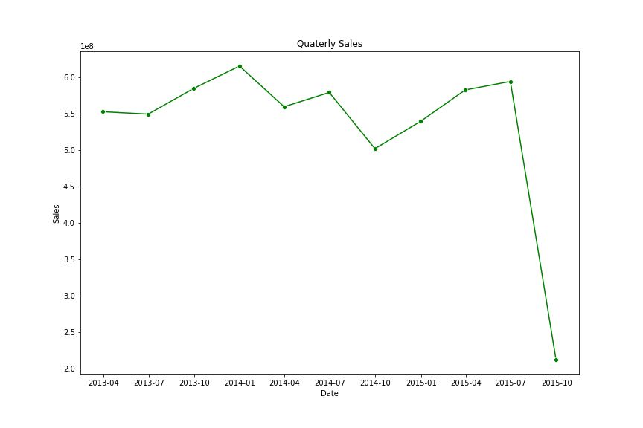
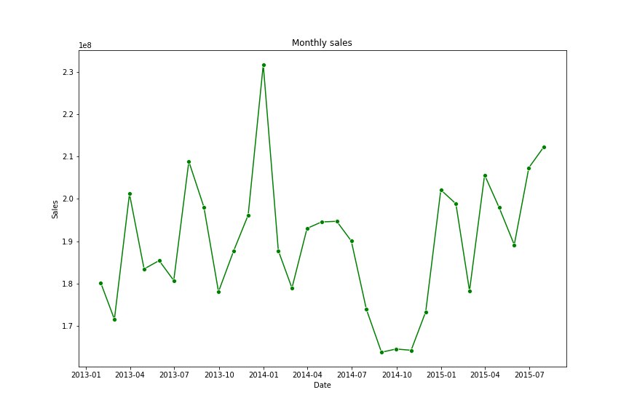
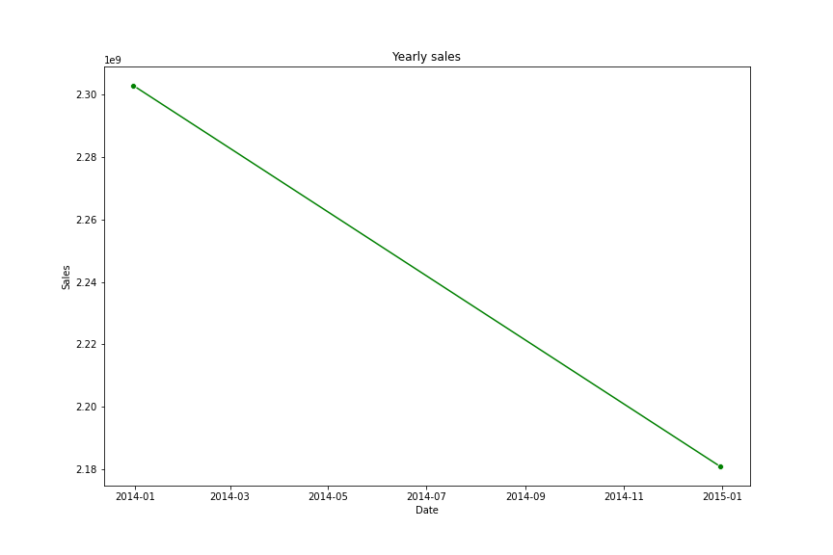
Trends – quarterly & Monthly sales
Data shows sales from 2013-01-01 to 2015-07-31
The sales declined by approx 5% from 2013 to 2014
Sales have decreased from 2013-2014, indicating a downward trend

Slide 3
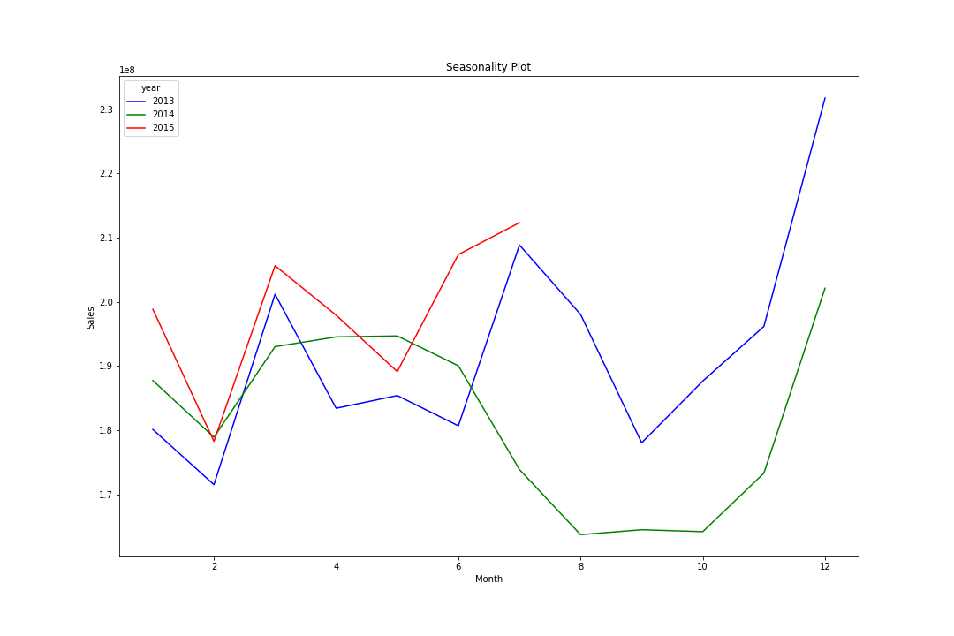
Sales Seasonality
Patterns:
Jan – Feb : Low Sales in all years
March – Spike in sales
Aug – Sept : Fall in Sales
Oct - Dec – Exponential Increase in Sales

Slide 4
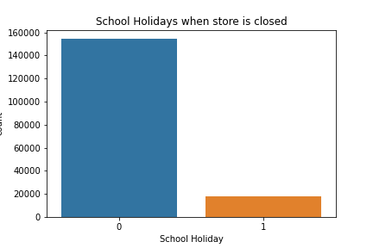
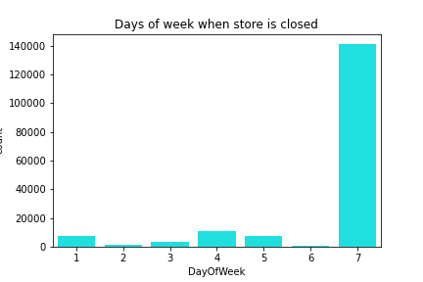
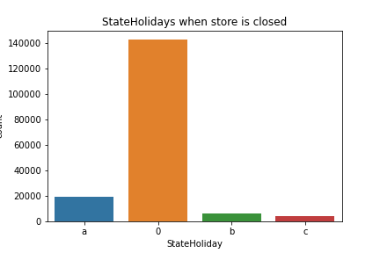
Analysis of Days and Holiday when store is closed
Stores are primarily closed on Sundays.
The store closure seems to be independent of school holidays and state holidays. While the store was closed, schools were typically open and there weren't any state holidays, indicating minimal influence from these factors.

Slide 5
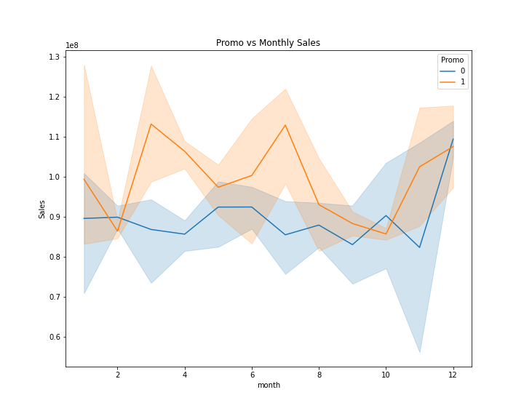
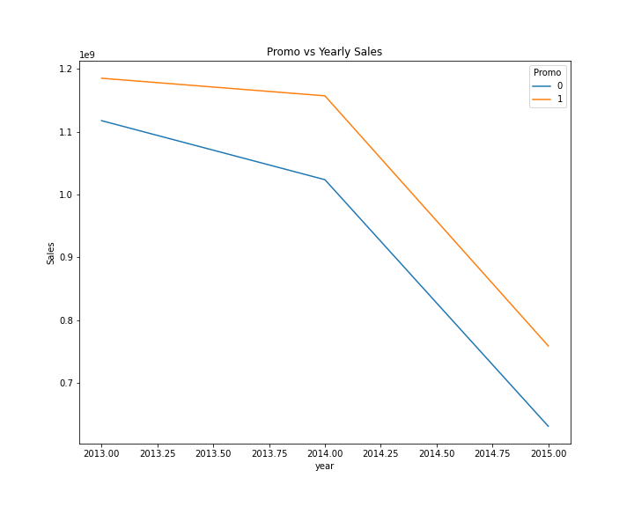
Effect of promotions on sales
Promotion lead to a drastic increase in Sales

Slide 6
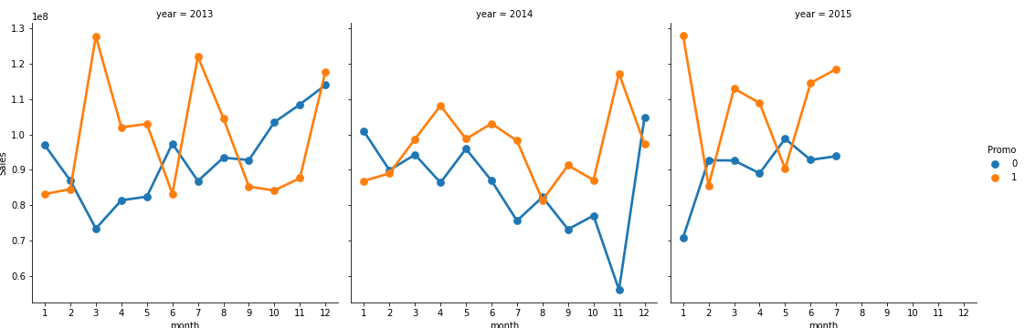
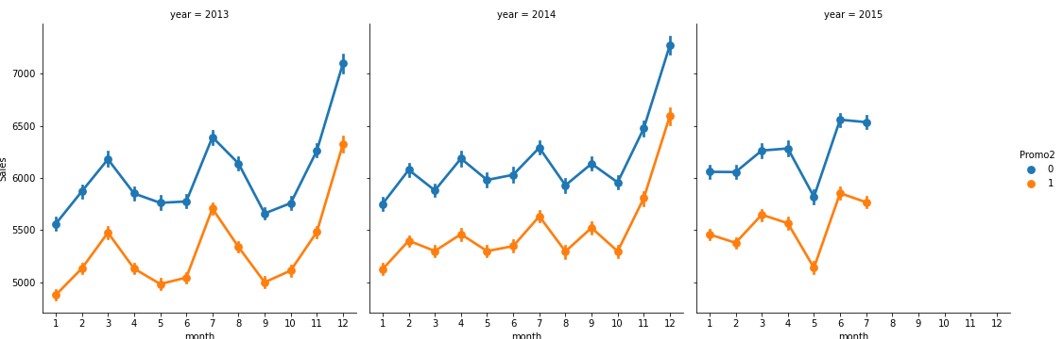
Effect of promotions on sales
Sales decreased with Promo2 unlike in Promo
Promo
Promo2

Slide 7
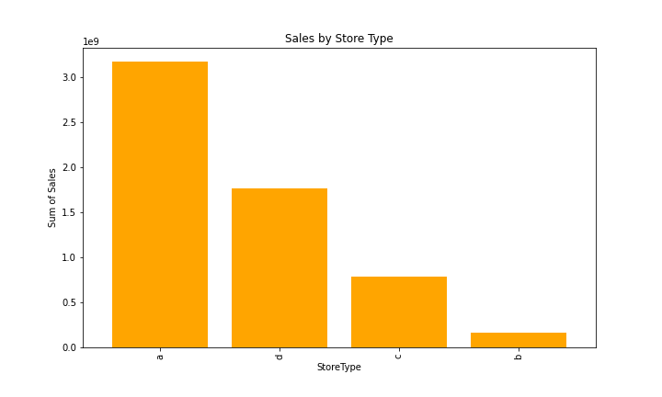
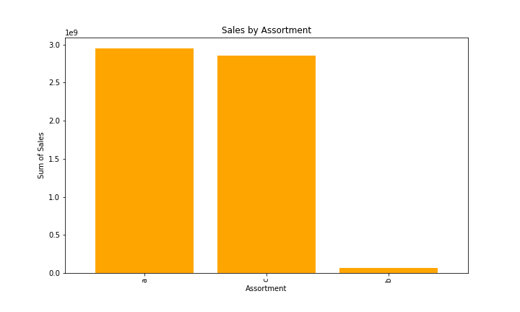
Sales by Store type & ASSORTement
Store A type does the maximum sales
Store B type does the minimum sales
Assortment A has the highest Sales
Assortment B has the lowest Sales
a = basic, b = extra, c = extended

Slide 8
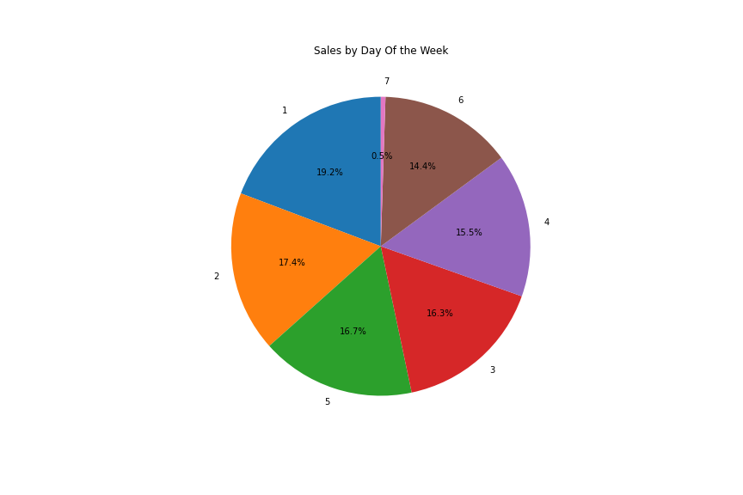
Sales by day of the week
Sales is almost same on all days expect Sunday
Maximum sales in observed on Monday and Tueday

Slide 9
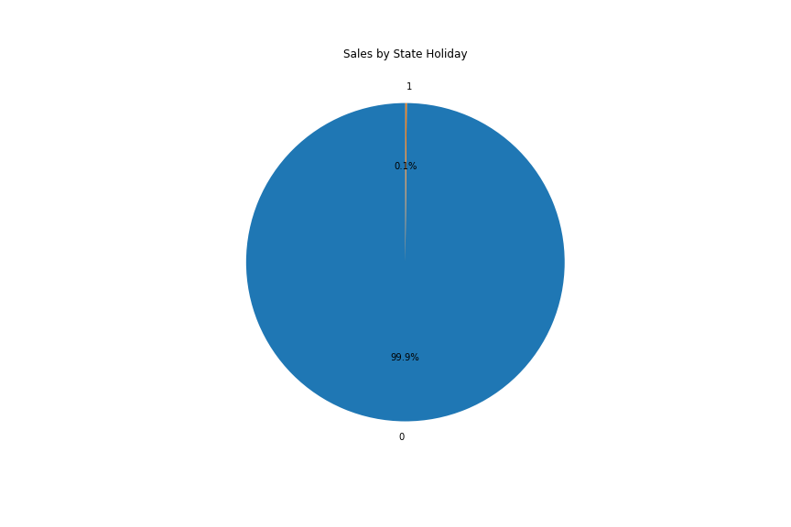
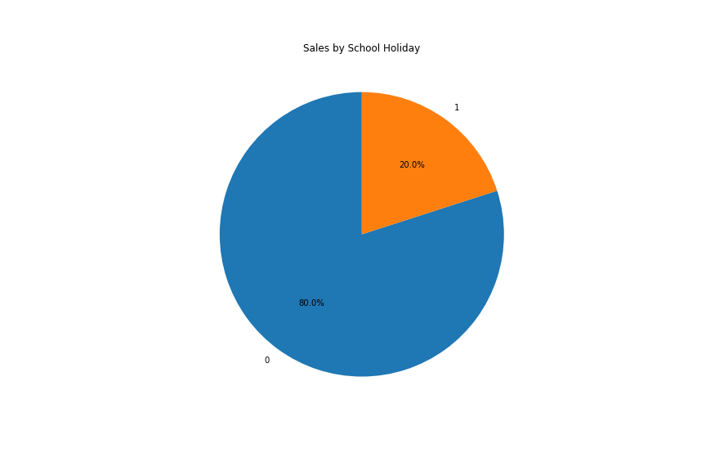
Sales by school holiday and state holiday
20% sales came from School Holidays and only 0.1% sales came from state holiday.
This show very insignificent effect of Holiday on Store sales

Slide 10
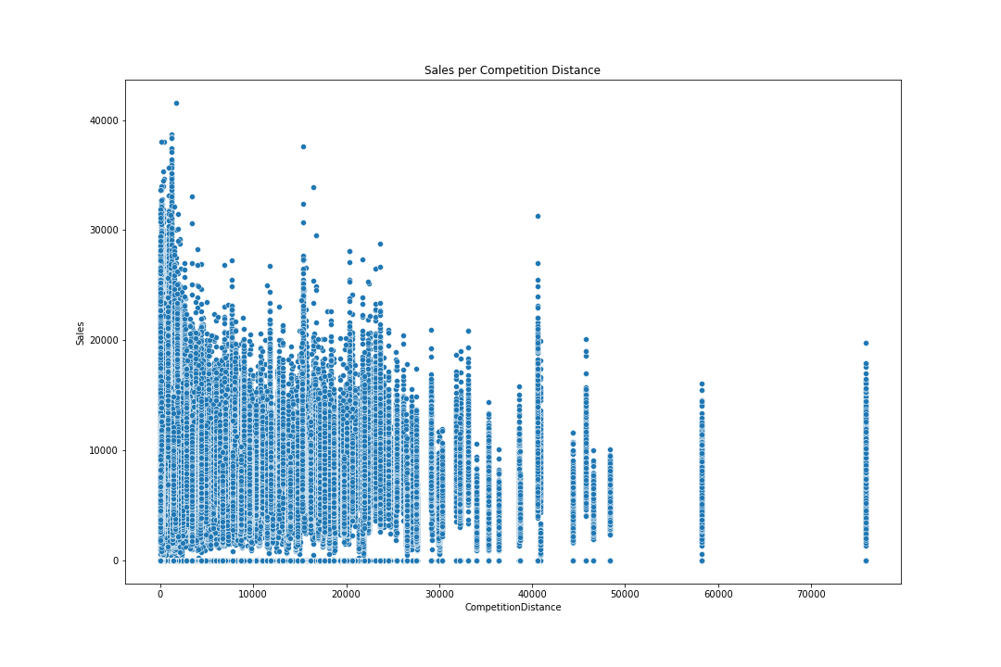
Sales by Competition distance
Highest sales was recorded in stores where competition is very close.
Data shows that less the competition distance more the sales

Slide 11
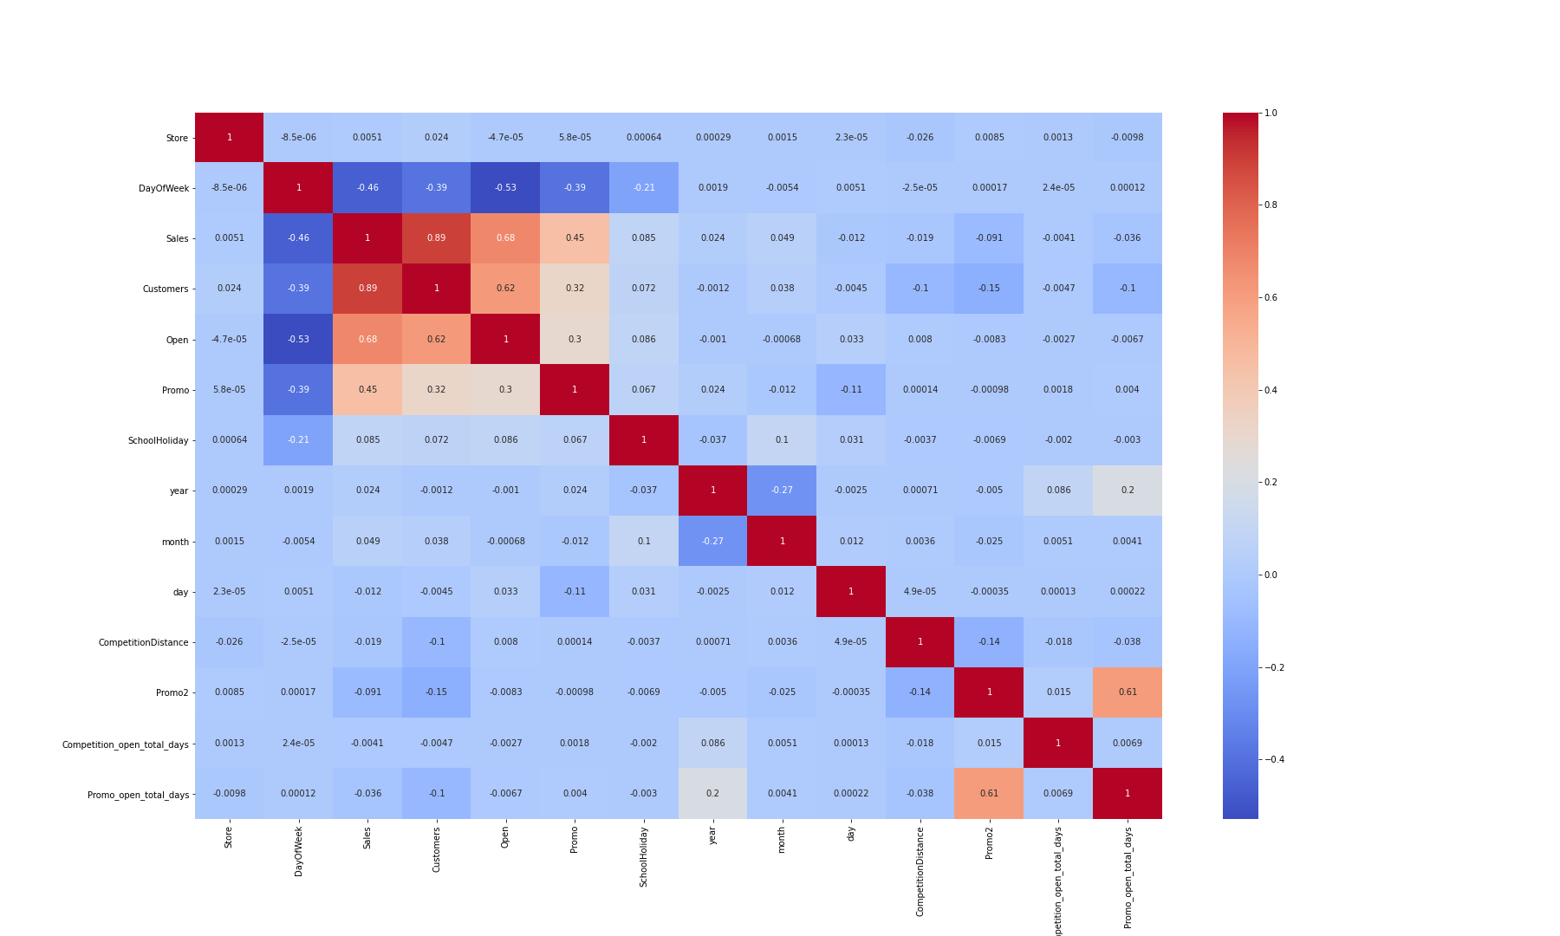
Correlation

